Slide 1
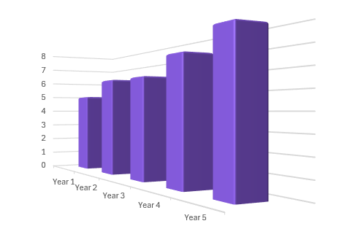
Misleading data
Task A: Misleading graphs
1) Why might the graph in this advert be misleading?
“Studies show our toothpaste is much more effective at promoting healthy teeth and gums than regular toothpaste.”
Premium toothpaste
Regular toothpaste
2) This chart shows the profit of a company (in thousands) over a 5 year period.
a) What elements of this chart might make it misleading?
Profit (1000s)
b) Why do you think the company chose to draw it this way?

Slide 2

Misleading data
3) Jacob records the average temperature in one of his classrooms each month and draws this graph.
a) What conclusion might he be trying to convey with this graph?
26
✖
Classroom temperature (°C)
25
✖
b) Why is his graph misleading?
✖
✖
✖
24
✖
Month
March
April
May
June
July
Sept
4) Sofia collects this data on how long she spends on different activities on a Saturday.
Activity | Time
Sleeping | 9 hrs
Exercising | 3 hrs
Seeing friends | 4 hrs
Screen time | 5 hrs
Family time | 3 hrs
a) What type of chart could Sofia draw to display this data?
b) Sofia wants to make it look like she spends lots of time exercising, how could she manipulate her chart to imply this?

Slide 3
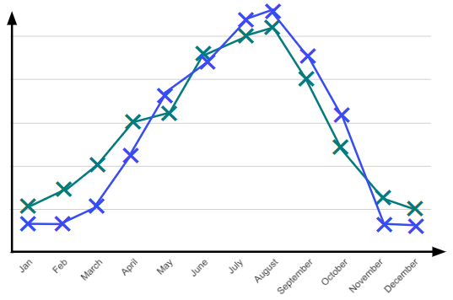


Misleading data
Task B: Misinterpreting graphs
1) Alex drew this chart from data he collected about how pupils travel to school.
60
✖
a) The school newspaper reports, ‘Only 50 pupils walked to school in the 2022/23 academic year’. Is this supported by Alex’s chart?
50
✖
40
✖
Percentage of pupils who walk to school
✖
30
20
10
20/21
21/22
22/23
23/24
year
b) The headline of the article states, ‘Fewer young people choose to walk to school now than in the past’. Is this supported by Alex’s chart?
✖
2) This time series graph shows the number of shark attacks and the number of heat stroke sufferers throughout the year.
Shark attacks
✖
Cases of heat stroke
The more shark attacks there are the less likely people are to go in the sea so they are more likely to get heat stroke. Shark attacks cause heat stroke!
a) Does the graph support the claim that shark attacks cause heat stroke?
Jacob
b) Suggest a possible reason why there is a similar pattern between these variables.

Slide 4


Misleading data
3) Here is a sketch of a scatter graph showing the number of times people visit restaurants and the value of their car.
So all I need to do is eat out more then I will be able to get a fancy car!
Sofia
✖
✖
✖
✖
Value of car
✖
✖
a) Does this graph show correlation between the number of times people visit restaurants and the value of their car? How do you know?
✖
✖
✖
✖
✖
✖
Number of times at a restaurant
b) Explain why Sofia’s statement is incorrect.
4) This chart shows the number of people who live in rural areas compared to urban areas.
This shows twice as many people live in urban areas than rural.
Alex
Sofia
I think it shows that 4 times as many people live in urban areas than rural areas.
Rural
Urban
a) Give a reason why Alex may be correct.
b) Give a reason why Sofia may be correct.
c) Give a reason why both may be incorrect.
Mathematics in Education and Industry
v2.4

